Slide 1
INFO1112 Tutorial
Week 6

Slide 2
Homework stuff
Homework 2 – More interviews today (For those who didn’t last week)
Homework 3 – Due Sunday 10th of September 11:59pm.
Now all submissions are done through git (Cannot edit on Edstem workspace)
Steps to submit
1. Install git on shell https://www.atlassian.com/git/tutorials/install-git
2. Navigate to homework 3 on edstem
3. Clone work workspace to shell
4. Code solution, commit changes, push

Slide 3
Brief summary of this week’s content

Slide 4

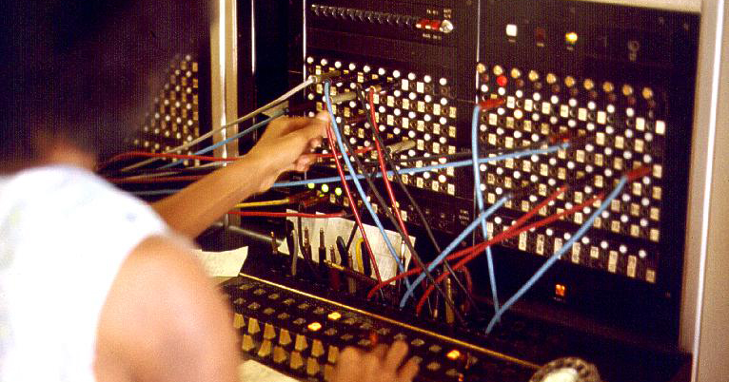

6.1 – Introduction to Networks
Internet was built upon technology used in telephone calls
Telephone calls originally used circuit switching
For two telephones to make a connection, a complete circuit had to be created
Telephone call would hop through different exchanges, where connections were made to connect the two telephones
Originally done by people!
Advantage:
each call had its own reserved bandwidth
Disadvantages
if no data is being transferred, that reserved bandwidth is now wasted
if the circuit was interrupted in some way (e.g. broken cable), the connection call must be re-established from scratch

Slide 5

6.1 – Introduction to Networks
Packet switching is a technology developed to overcome shortcomings in circuit-switched communications
Rather than being sent along a continuous stream, data is broken down into smaller packets
Packets travel independently from sender to receiver – they don’t have to necessarily follow the same path!
Important thing is that all data is transmitted

Slide 6
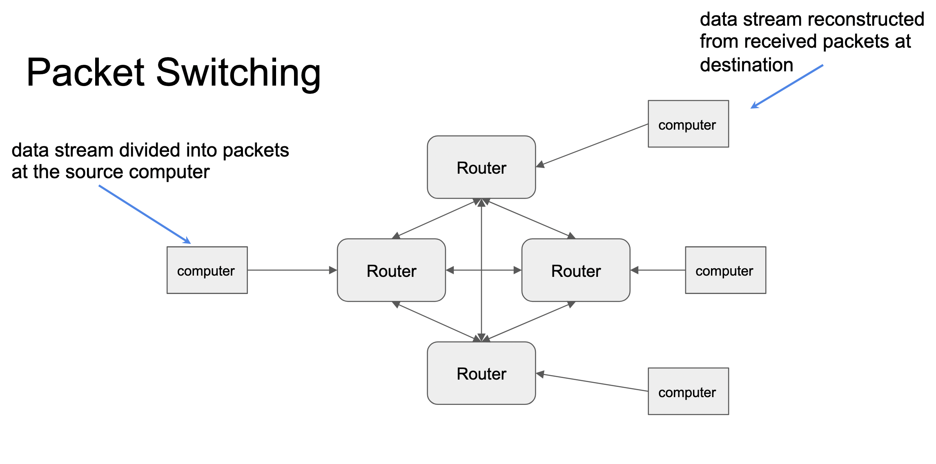
6.1 – Introduction to Networks

Slide 7
6.1 – Introduction to Networks
As packets follow different routes around a network, they can be rerouted as needed, for example, in the case of:
congestion on one connection
a connection is broken
Rerouting gives data sent through packet switching resilience
Furthermore, packet switching allows for multiple packets from different sources to be sent over the same connection

Slide 8
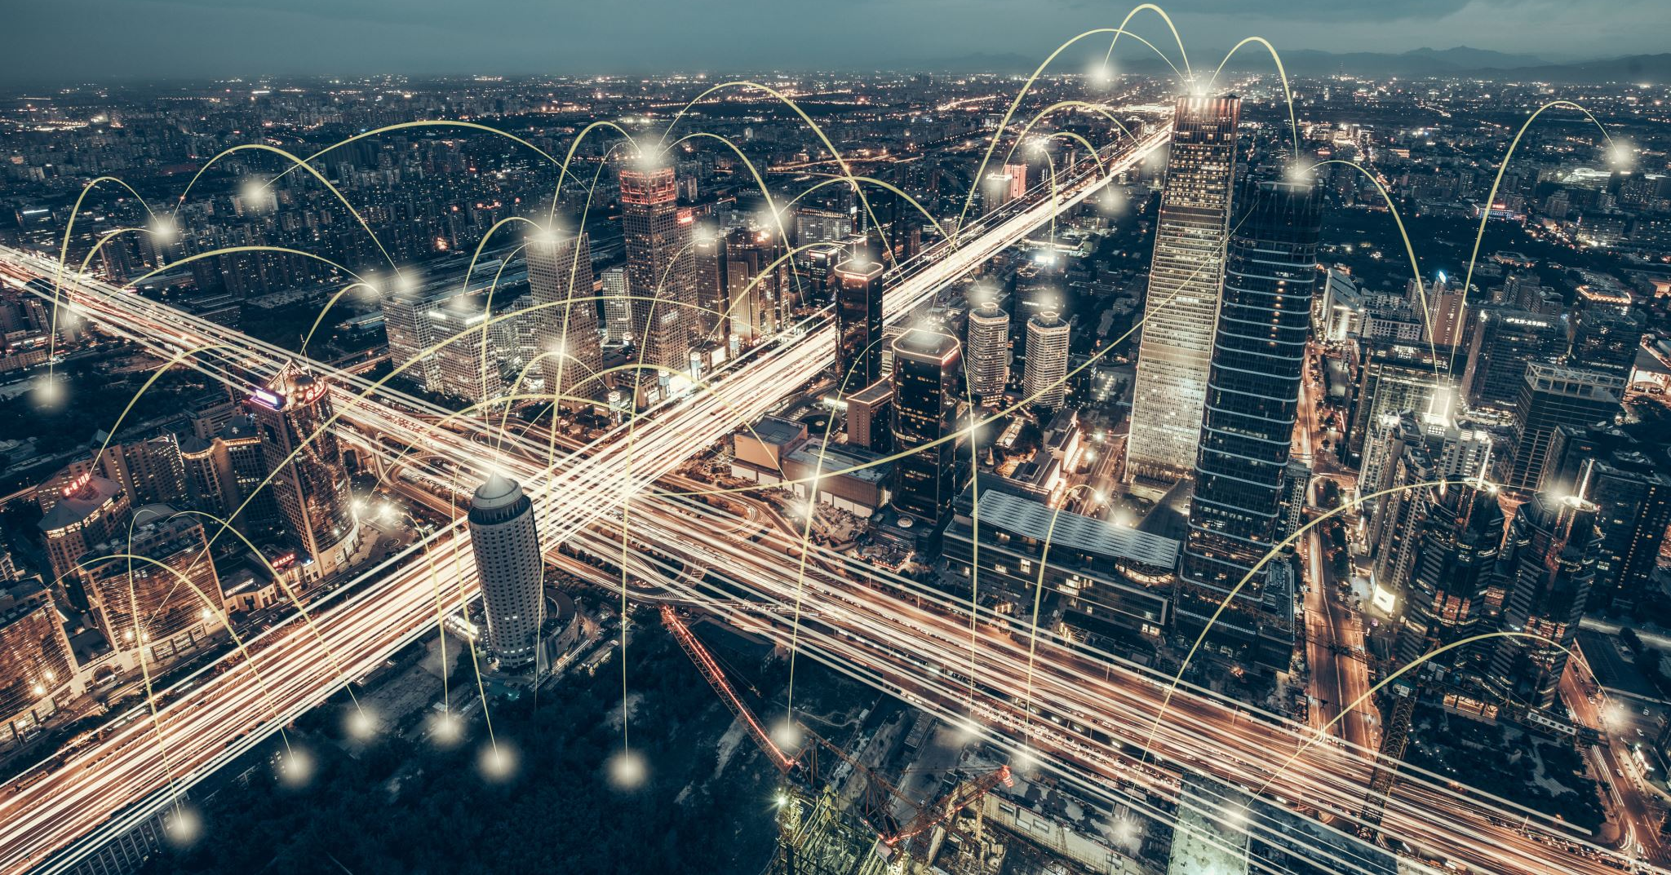
6.1 – Introduction to Networks
Local area networks (LAN) – networks that are localised to one specific location, such as a house, business, or university campus
Wide area networks (WAN) – networks that connect multiple LANs together to create a larger, interconnected network – i.e. all LANs connected in Sydney, or indeed, the Internet
LANs are generally connected with ethernet technology (for wired connections), or Wi-Fi for wireless networks
Router used to route internet data correctly to connected devices
Routers connect to modems, which connect to the outside Internet, and are used to convert between analogue → digital data when downloading, or digital → analogue data when uploading (hence the name: modulator-demodulator)
Most modern home routers are combined with a modem in a single package

Slide 9
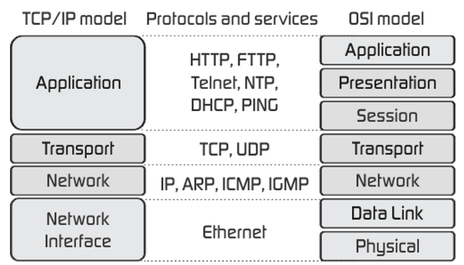
6.1 - Introduction to Networks
Protocol – set rules/standards which dictate how communication should occur between two devices
Many protocols used in network communications
Protocols can be divided up into “layers”
“Internet Protocol Suite” or “TCP/IP Model” dictates basic, functional layers of protocols
OSI model is more of a theoretical (rather than practical) layout of protocol layers
As data packets move down the protocol stack, the lower layers wrap the packet in more information with their own headers and footers
As the data packets move up the protocol stack, these headers/footers are removed to access data

Slide 10

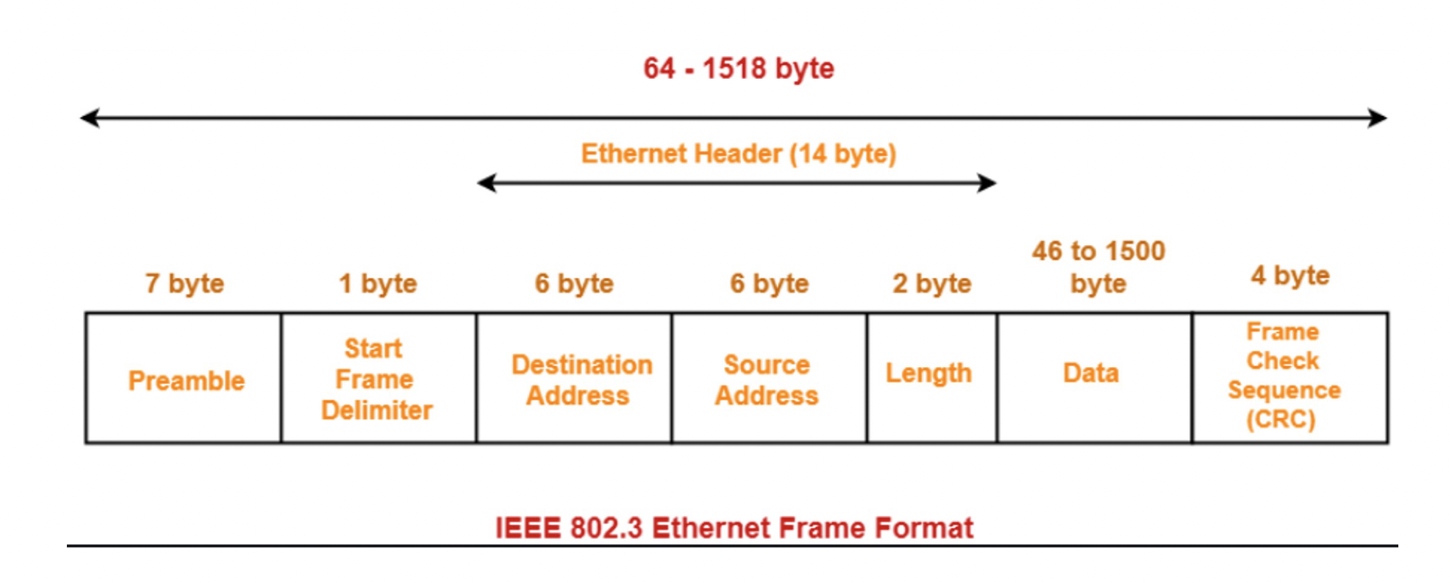
6.1 – Introduction to Networks
Examples of protocols:
Ethernet – protocol in the “Link” (lowest) layer of internet protocol suite
Ethernet packets are used to transfer data from one point to another point in a network (e.g. from one router to another)
Packets only exist for this single “hop”, before they are unwrapped and wrapped up again to get to the next point
Uses MAC address to store information on source, and find destination of “hop”
Unique address for all devices which connect to the internet

Slide 11
6.1 – Introduction to Networks
Examples of Protocols
Internet Protocol (IP) – used for communication between any two devices connected to the Internet
Header contains destination address and source address
IPv4 address is 4 bytes long, and written in 4 sections (e.g. 129.168.0.1)
Difference between local IP address and public IP address
Public IP address is what is used to communicate over the internet
Router is able to use IP packet to convert a public IP into a local IP address
When a data packet gets to the IP layer, the router finds the next device in which the packet should “hop” to to get to its destination, and puts this in a surrounding ethernet frame
Transmission Control Protocol (TCP) – used in order to check for any errors during data packet transmission that may have occurred by calculating checksum
Compares calculated checksum to checksum stored in header

Slide 12
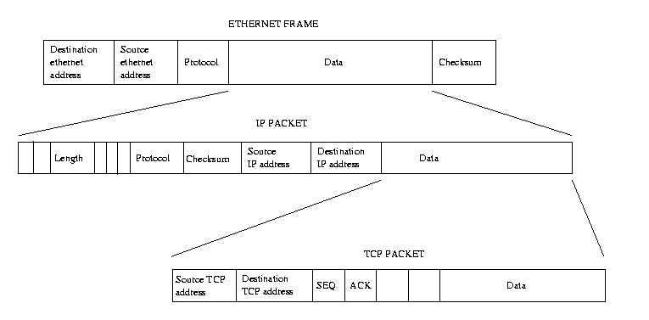
6.1 – Introduction to Networks

Slide 13
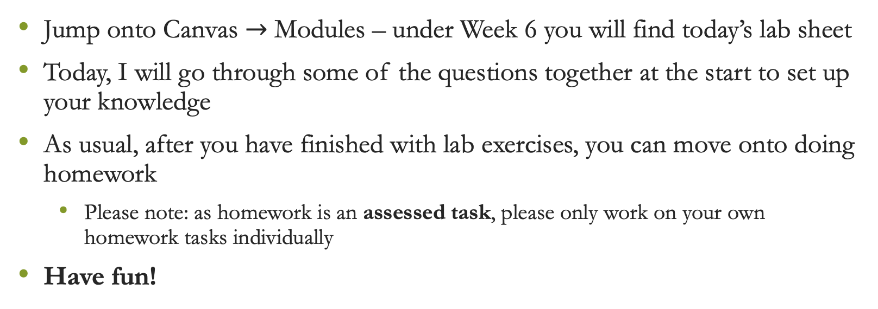
Lab exercises
Jump onto Canvas $→$ Modules – under Week 6 you will find today’s lab sheet
Today, I will go through some of the questions together at the start to set up your knowledge
As usual, after you have finished with lab exercises, you can move onto doing homework
Please note: as homework is an assessed task, please only work on your own homework tasks individually
Have fun!

Slide 14

Attendance
https://bit.ly/45lncOp

